Slide 1

Heart Disease Classification

Slide 2
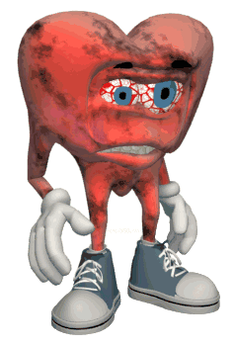
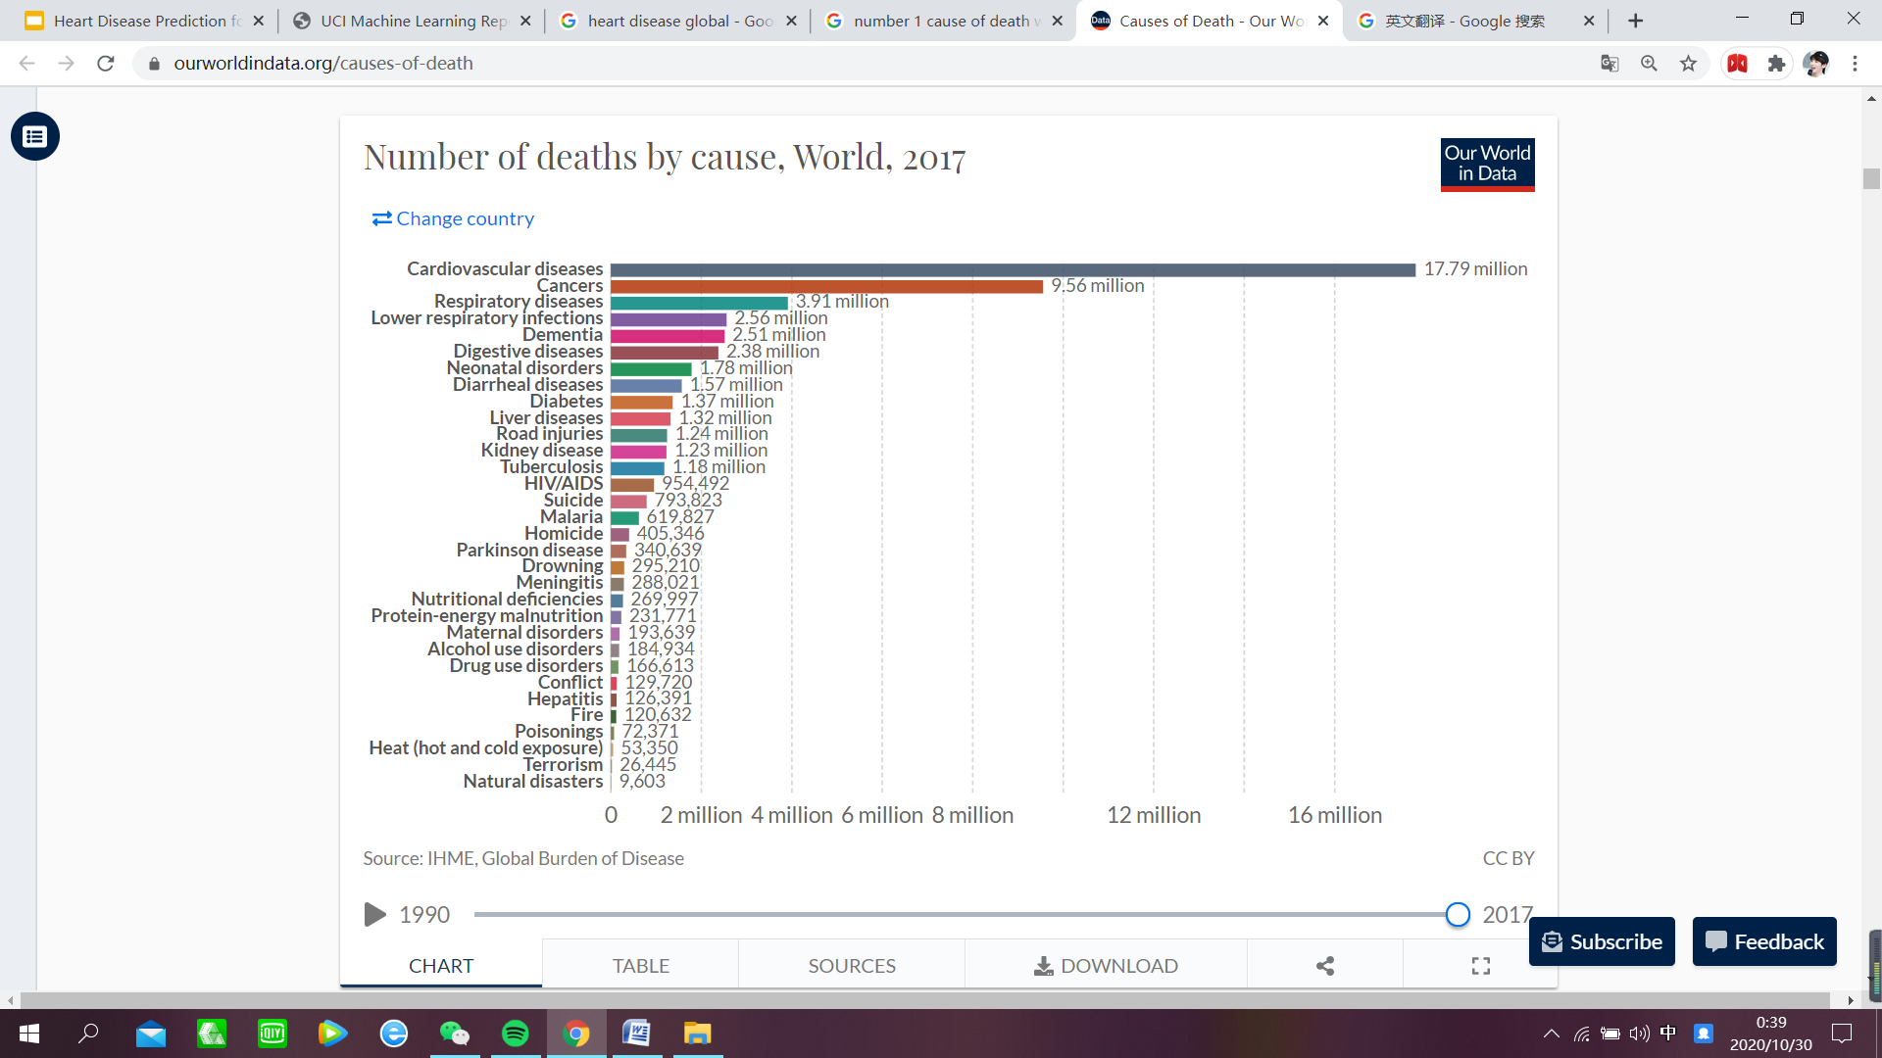
No.1 cause of death
17 million a year

Slide 3
Contents
01
02
03
04
Objective & Exploration
ML problems & decision tree
Data Preparation
& Apply ML
Results & Analysis

Slide 4

01
Objective & Exploration

Slide 5
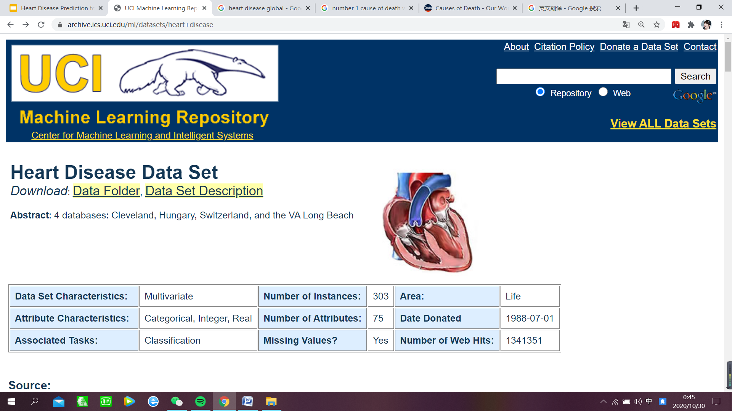
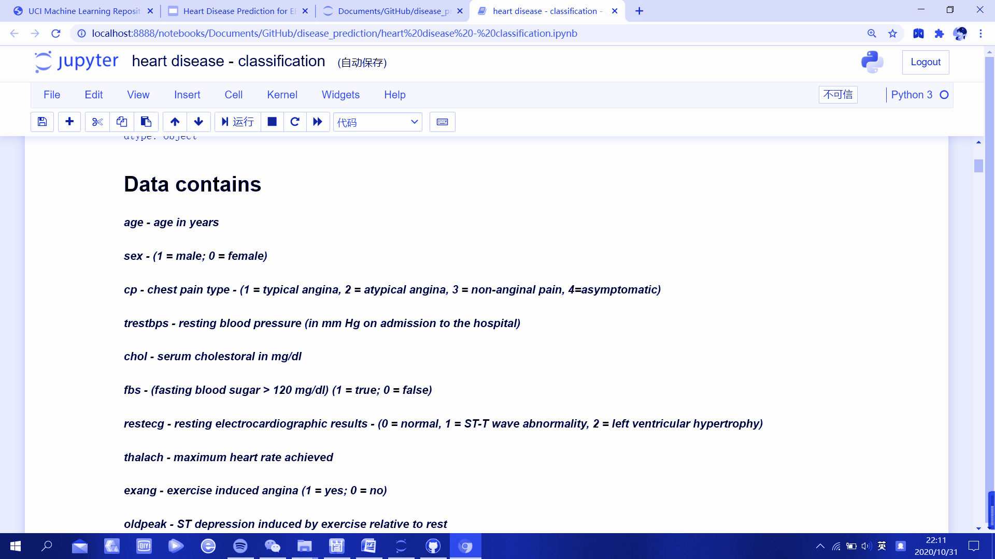
Dataset: Heart Disease Data Set

Slide 6
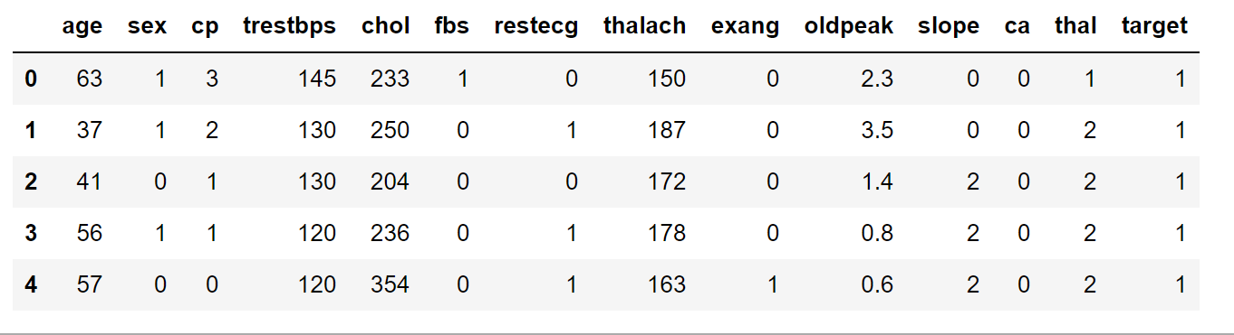
Objective
Find a most suitable classification model by comparing different models

Slide 7
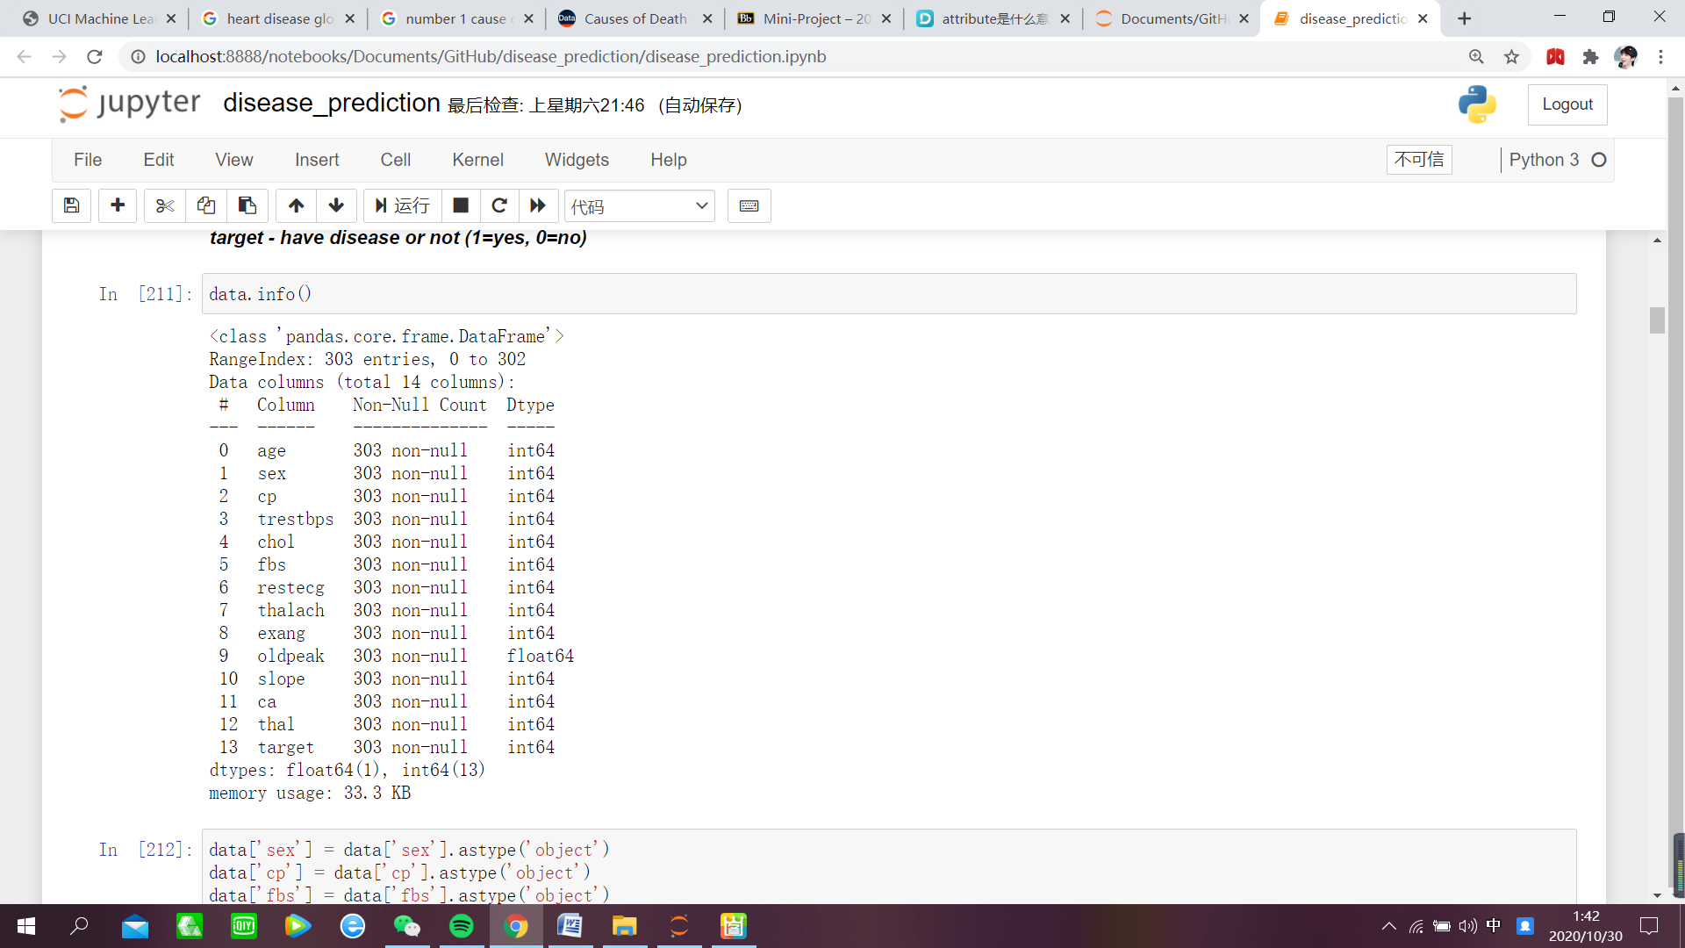
Clean dataset
Change data type
Numerical categorical

Slide 8
Clean dataset
Sex: 1 Male
0 Female
Target: 1 Yes
0 No

Slide 9
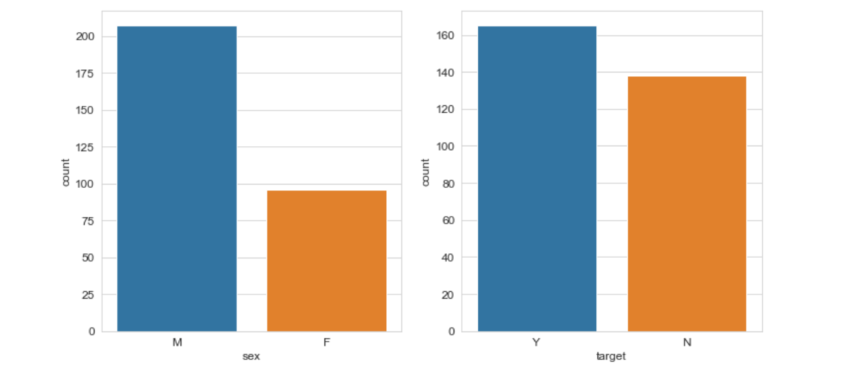
Data Exploration
sex
target

Slide 10
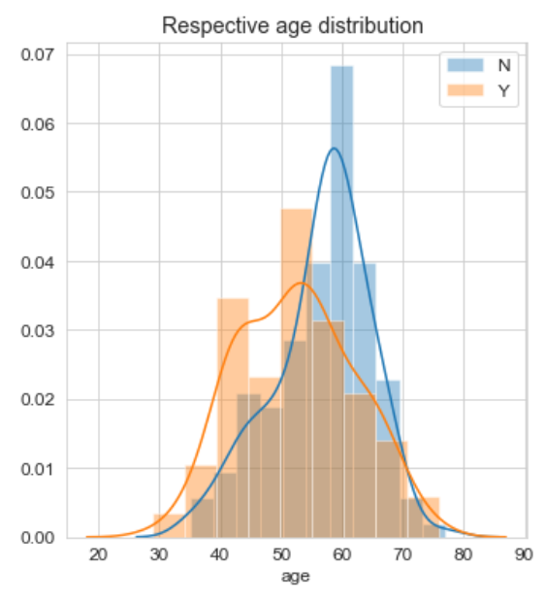
Data Exploration
People aging from 45-60 are more likely to have heart disease
age

Slide 11
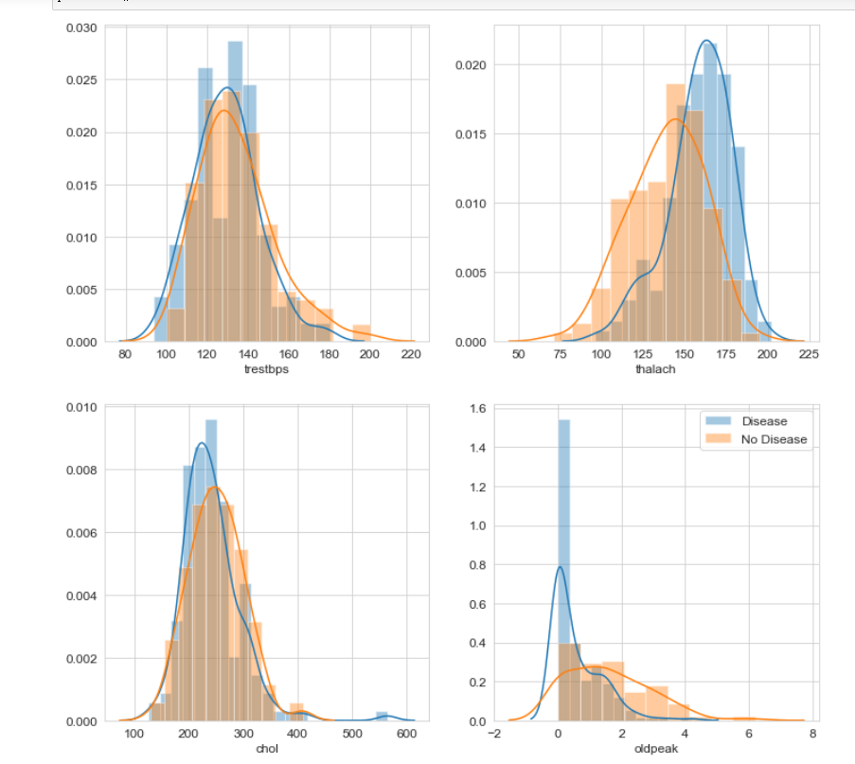
Data Exploration
Thalach
(max heart rate achieved)

Slide 12
02
Machine Learning Problem & Decision Tree

Slide 13
Machine Learning Problem
Classify people with or without heart disease based on their physical conditions
By using several machine learning models to do the classification
Compare the accuracies of each model and select the most efficient one for this problem

Slide 14
Machine Learning Techniques
Decision tree
Naive bayes classification
Logistic regression
Support vector machine
Random forest classification
Why we choose these five methods ------
The data contain different data types and there are different relationship among variables
It is difficult to measure the effect of variables on the results

Slide 15
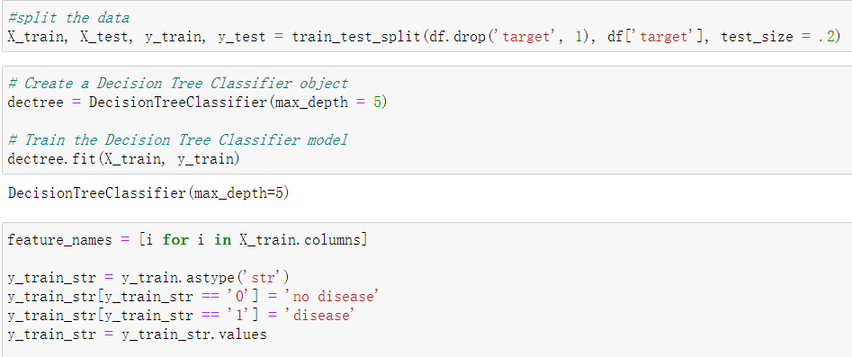
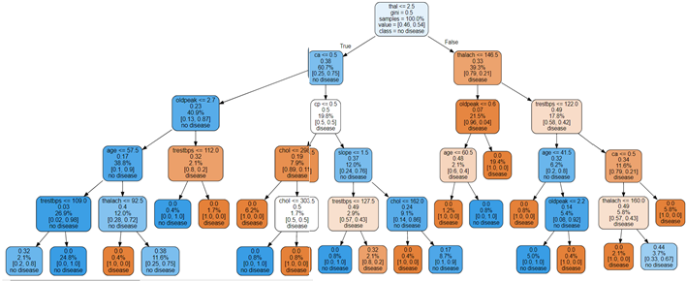
Decision tree model
Use x_train y_train to train the model
The decision tree shows the proportion of disease and no disease

Slide 16
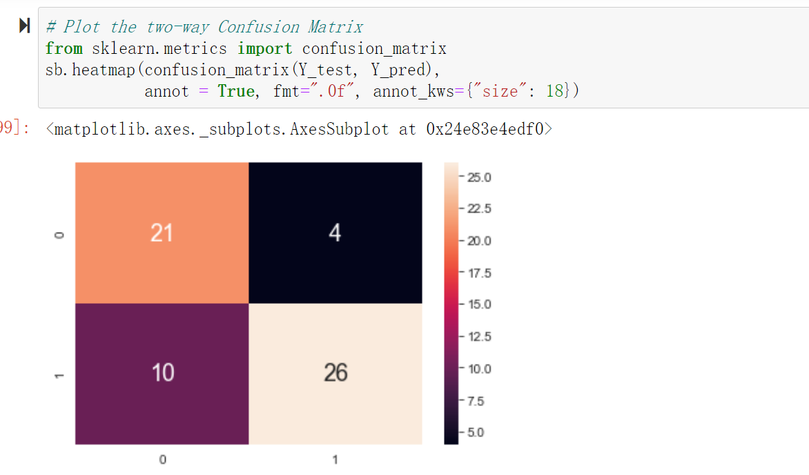
Decision tree model
Sensitivity and specificity are statistical measures of the performance of a binary classification test that are widely used in medicine

Slide 17
03
Data Preparation
& Apply ML
Prepare the data before applying the machine learning technique

Slide 18
Data Preparation
Clean Data
Dummy variables
Normalize
Split train/test
We clean the data before applying the machine learning techniques.
Dummy variables are dichotomous, quantitative variables.
Rescaling data to have values between 0 and 1.
Split x,y from the dataset and split them as train/test data

Slide 19
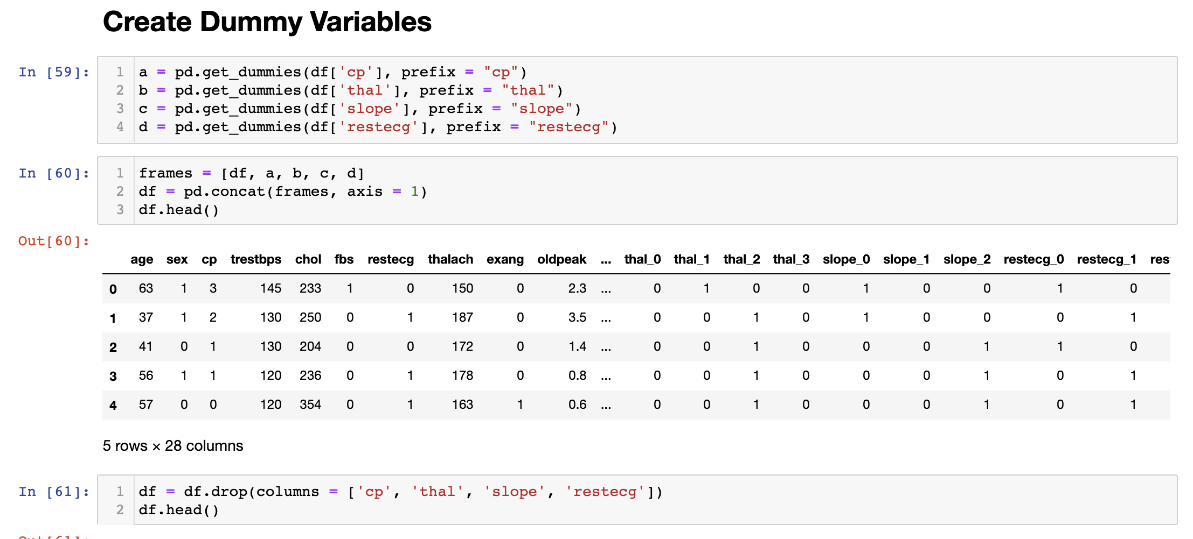
Dummy variables
Dummy variables are dichotomous, quantitative variables.
Change Category data to its dummy form.

Slide 20
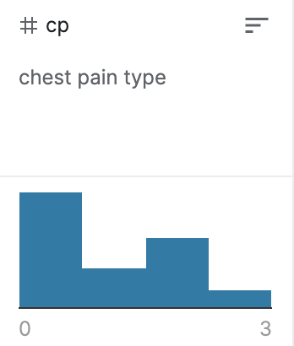
Dummy variables
CP (Chest pain type): 1,2,3
Convert CP to CP1, CP2 WITH CP3.
Original 1 = {CP1 = 1, CP2 = 0, CP3 = 0}
Original 2 = {CP1 = 0, CP2 = 1, CP3 = 0}
Original 3 = {CP1 = 0, CP2 = 0, CP3 = 1}

Slide 21
Data Normalize
Scale a variable to have a values between 0 and 1

Slide 22
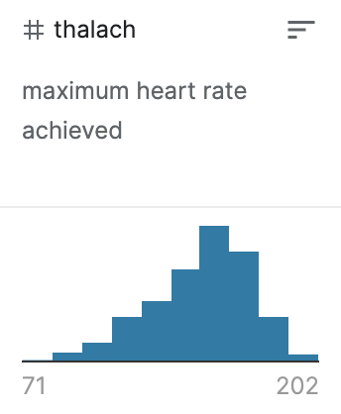
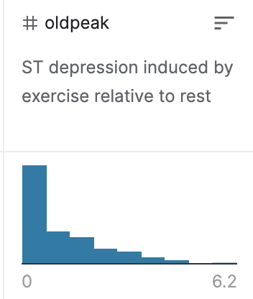
Data Normalize
Thalach range: 71 ~ 202
Oldpeak range: 0 ~ 6.2
Thalach range: 0 ~ 1
Oldpeak range: 0 ~ 1

Slide 23
Split train/test data
Randomly select 20% of the data as test data

Slide 24
Apply Machine learning

Slide 25
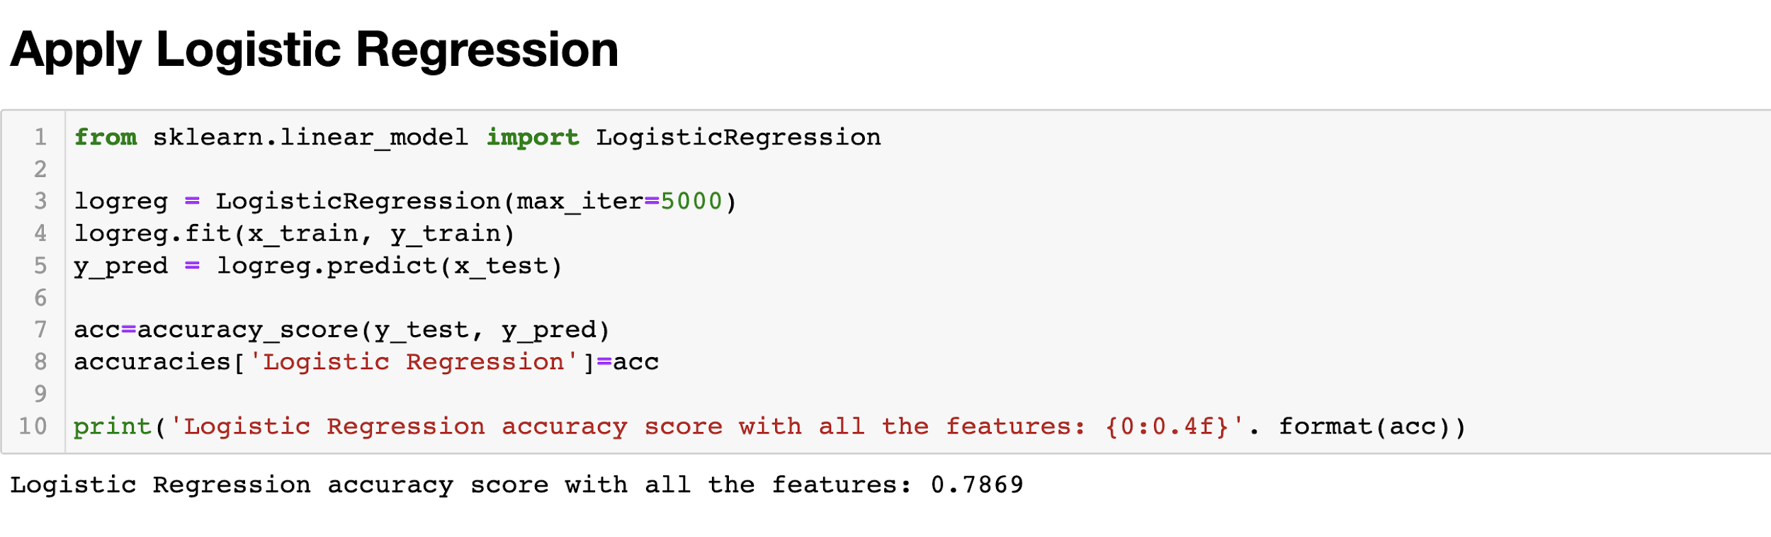
Machine Learning Techniques
Decision tree
Naive bayes classification
Logistic regression
Support vector machine
Random forest classification
How we apply these five methods ------

Slide 26
04
Results and Analysis

Slide 27
Objective
Find a most suitable classification model by comparing different models
Classification Accuracy
Sensitivity and Specificity

Slide 28
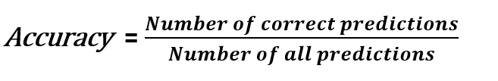
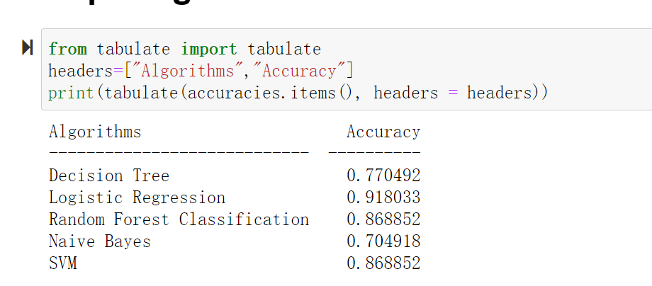
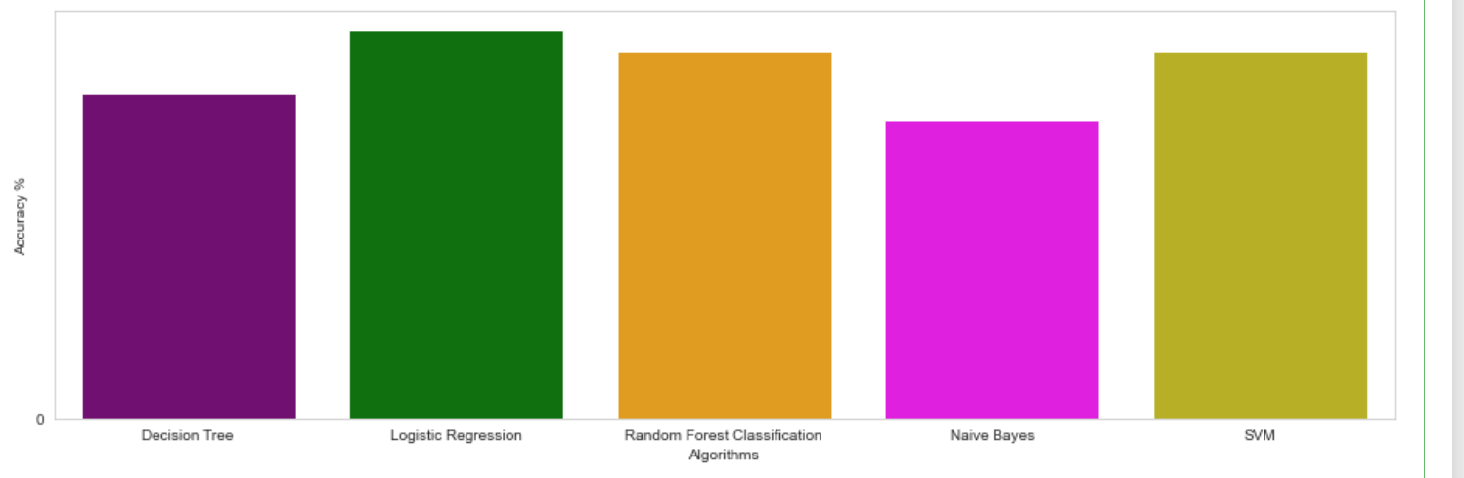
Classification Accuracy
Classification accuracy shows how many of the predictions are correct.

Slide 29
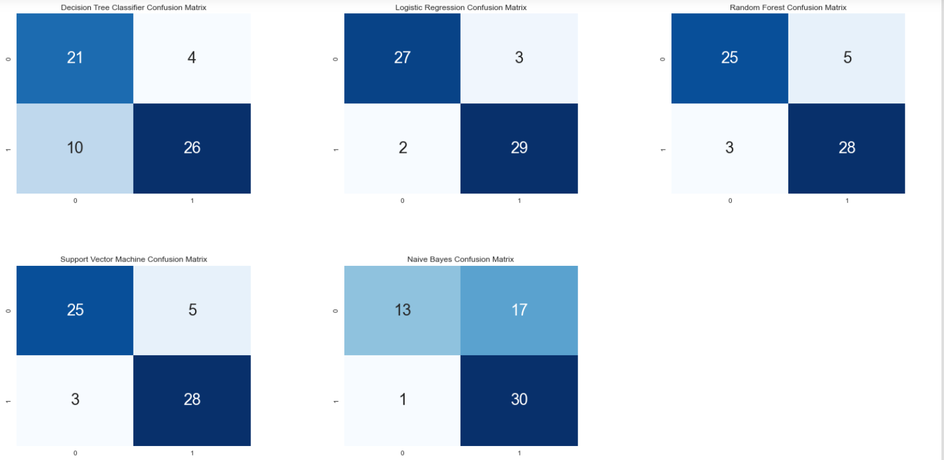
Confusion Matrix

Slide 30
Sensitivity and Specificity
Sensitivity measures the proportion of positives that are correctly identified
(e.g., the percentage of people with heart disease who are correctly identified as having heart disease)
Specificity measures the proportion of negatives that are correctly identified
(e.g., the percentage of healthy people who are correctly identified as not having heart disease).

Slide 31
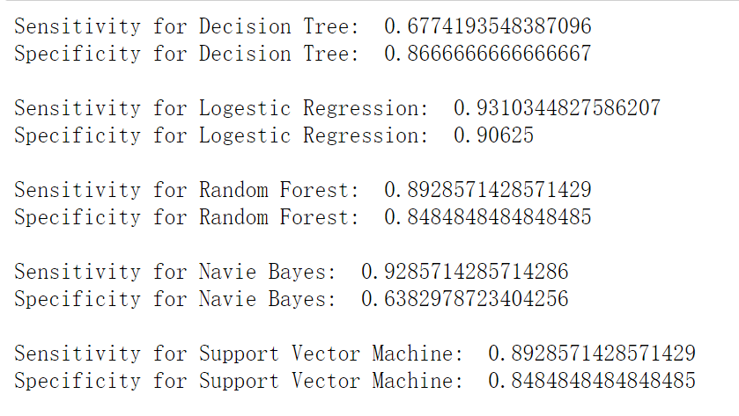
Sensitivity and Specificity

Slide 32
Conclusion
By comparing different machine learning models, we identify that Logistic Regression Model fit most well for this problem and dataset with an accuracy of 0.9180(quite stable).
Naive Bayes Model have a rather dynamic accuracy (0.5-0.8)
Logistic Regression is also the best method if sensitivity and specificity is checked.
Decision tree
Naive Bayes Classification
Logistic regression
Support Vector Machine
Random forest classification

Slide 33
Group Work
Zhao Lan
Gong Zeyu
Introduction
Finalise exact objective
Clean dataset
Data exploration and visualization
Clarify our machine learning problem
Study and code on Decision Tree Classification
Study and introduce some new machine learning techniques to teammates.
Liu Ruiqian
Su Hang
Study and introduce Github to the team;
Study and code on Data Preparation;
Study and Implement codes on Logistic Regression and random forest classification models
Implement codes for Naive Bayes and Support Vector Machine (SVM) models;
Make the table and plot for accuracy comparison; Confusion matrix and codes for calculating Sensitivity and Specificity;
Summarize the results and outcome and ppt for the final part.

